Slide 1

Probabilistic Software Workshop
September 29, 2014
DNA·VIEW® Mixture Solution™
Charles H. Brenner, Ph.D.

Slide 2
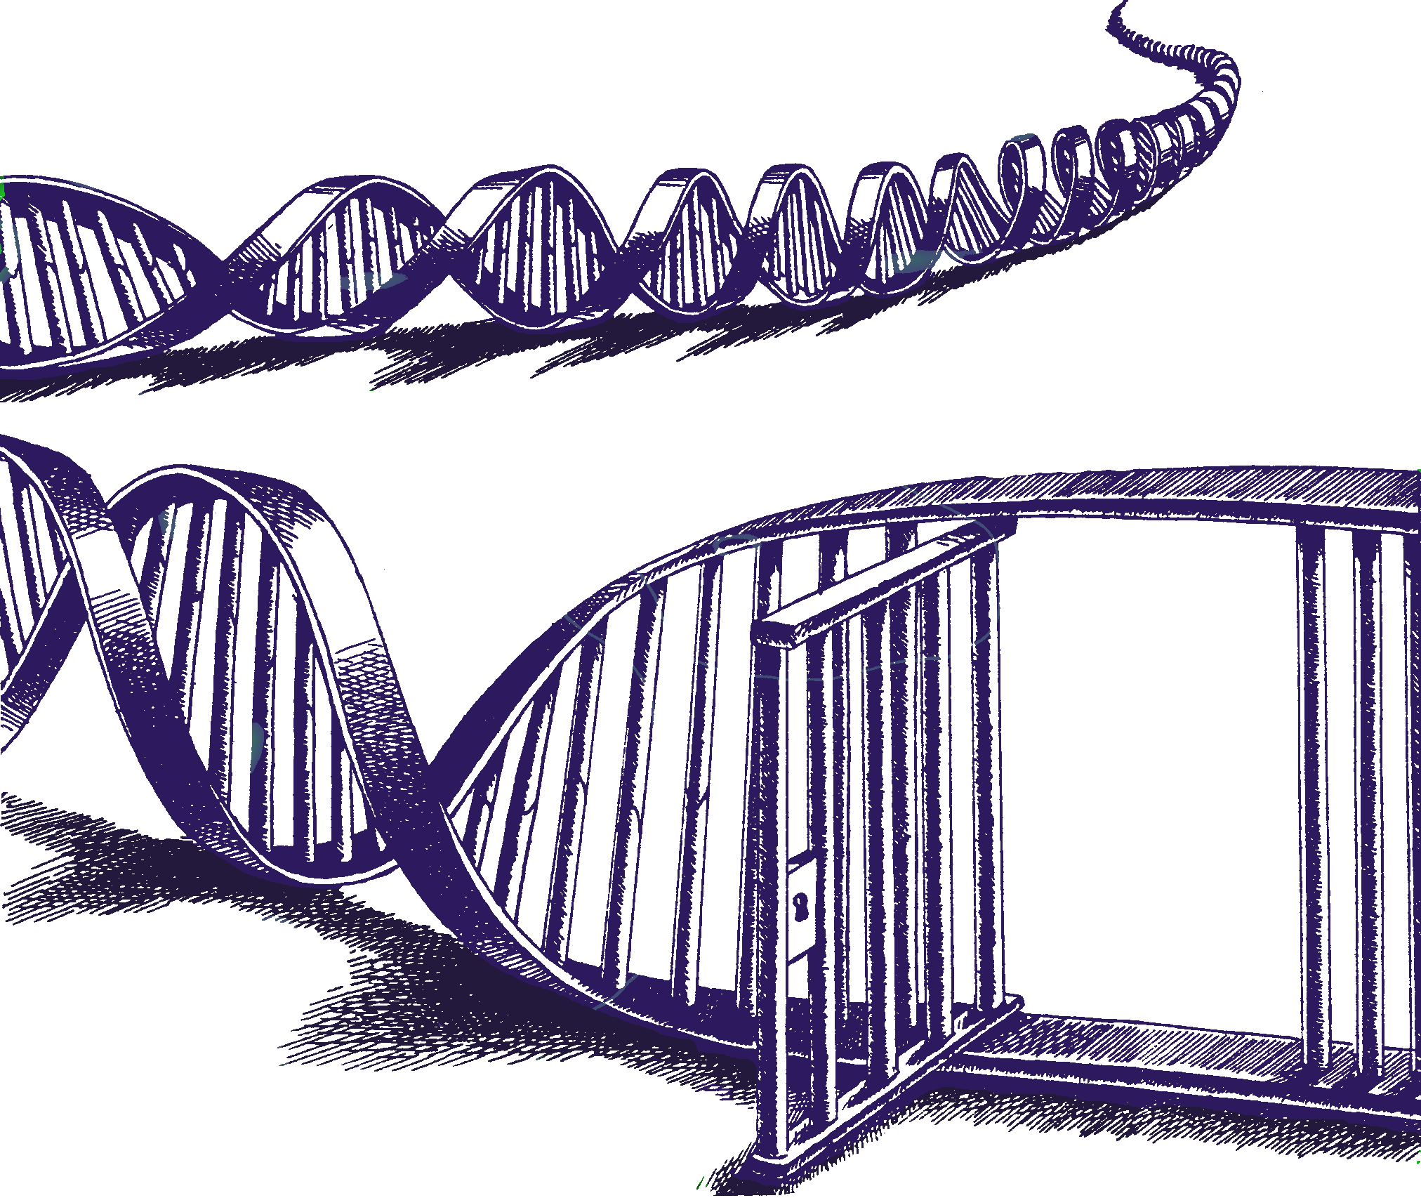
DNA·VIEW® Mixture Solution™
Incredible insights into complex mixtures
Charles Brenner, Ph.D.
Purveyor of forensic mathematics, DNA∙VIEW,
Visiting Scholar, Senior Research Fellow at UC Berkeley Human Rights Center
http://dna-view.com cbrenner@berkeley.edu

Slide 3
Mixtures past & future
What –
  traditional (rape, murder(fingernail), …)
  Now (gun grip, ski mask, grab touch)
    Lots more mixtures
    Cases with many suspects
    Mixtures with many possible references, or total # of contributors
History
  Binary – exclusion. Weir model.
  Thresholds (60% rule. Stochastic). Square pegs
  Simplifications favor the guilty
  Continuous
  Undefined terms – careless definitions impede progress
    contributor

Slide 4
Mixture analysis concepts
Traditional
Modern
Likelihood ratio
Two hypotheses
Alleles seen
“Contributor”
  # contributors
Likelihood ratio
Many hypotheses
  Likelihood
Florescent signal
  Continuum
  Future: quantized?
Degree of contribution

Slide 5
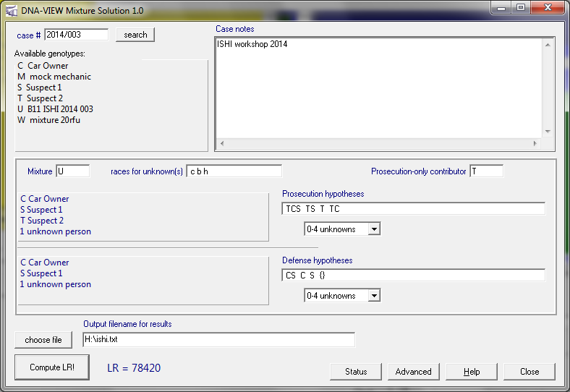
multiway mixture analysis setup

Slide 6
multiway mixture analysis setup

Slide 7
DNA·VIEW® Mixture Solution
Evidential value (likelihood ratio) for DNA mixtures
  Evaluates peak heights, dropout, drop-in, stutter
  “Continuous” method
  Fast, automatic
    Evaluate and compare many hypotheses
Only program to analyze correctly all of the NIST 2013 mixture exercises
peak heights
dropout
drop-in
stutter
Notes:
Speed good – allows doing more different experiments
1. for user
2. for program developer

Slide 8
Why “continuous” mixture model?
“Exclusion” approach is usually invalid
  “Complicated mixture, so we could only do CPE”
  That’s 180⁰ wrong.
  CPE formula: (p+q+r)² – implements the model:
    Suspect excluded unless all his alleles above threshold.
    Not how a real analyst excludes real suspects – especially for a hard mixture.

Slide 9
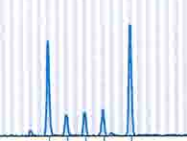
Towards a more realistic model
Must cope with dropout
Suspect allele not seen (at threshold)
  Can’t exclude suspect; we know dropout possible
  Can’t ignore the locus – unfair to suspect.
⇒Need probabilistic dropout treatment.
⇒Model dropout as stochastic phenomenon
⇒Consider continuum of signal intensity
⇒Continuous model

Slide 10
How does Mixture Solution work?
Mixture profile = observed alleles & intensities
Compare hypotheses H_{p} & H_{d};
  Hypotheses H_{i} are e.g.: “Mixture is explained as references C, T, & maybe some unknowns.”
  LR (likelihood ratio) is a ratio of L’s (likelihoods):

Slide 11
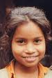
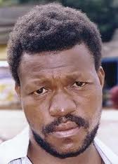

What goes into calculating L?
DNA profiles: mixture (including peak height); references.
There are some “nuisance variables”:
  # of unknowns
  Genotypes of unknowns
  Mixture contributor proportions for references & unknowns
  Race of each unknown
Atomic calculation = Pr(Mixture | references & specific a-d)
L = Atomic calc & eliminate all nuisance variables either by
  Optimizing – find & use best value (races, # unknowns), or
  Averaging over all possible values (genotypes, mixture proportions)
    E.g. consider all 10³⁹ genotypic combinations of 3 unknowns
0? 2?
(11,12)(11,13) (8,9.3)(9,10)

Slide 12
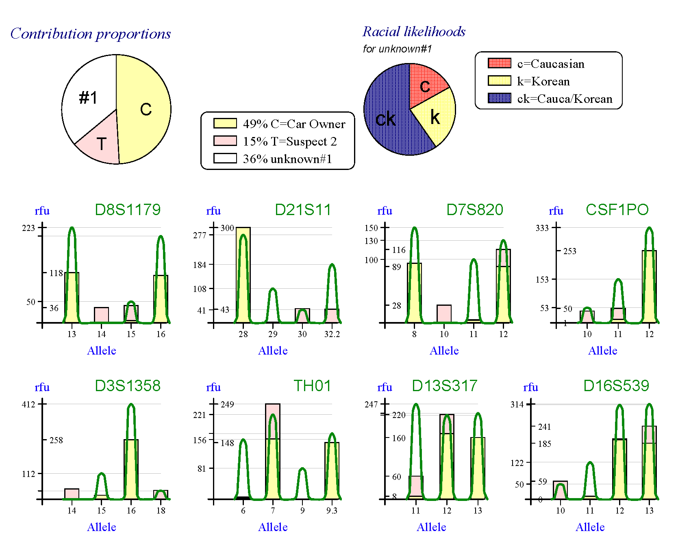
Visual aids
Car owner, suspect #2 & unknown
expected height

Slide 13
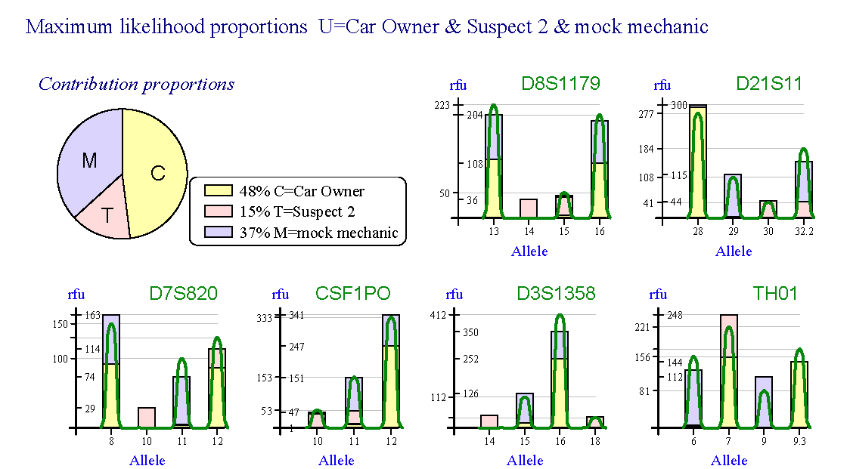
Visual aids contributor proportions & EPG

Slide 14
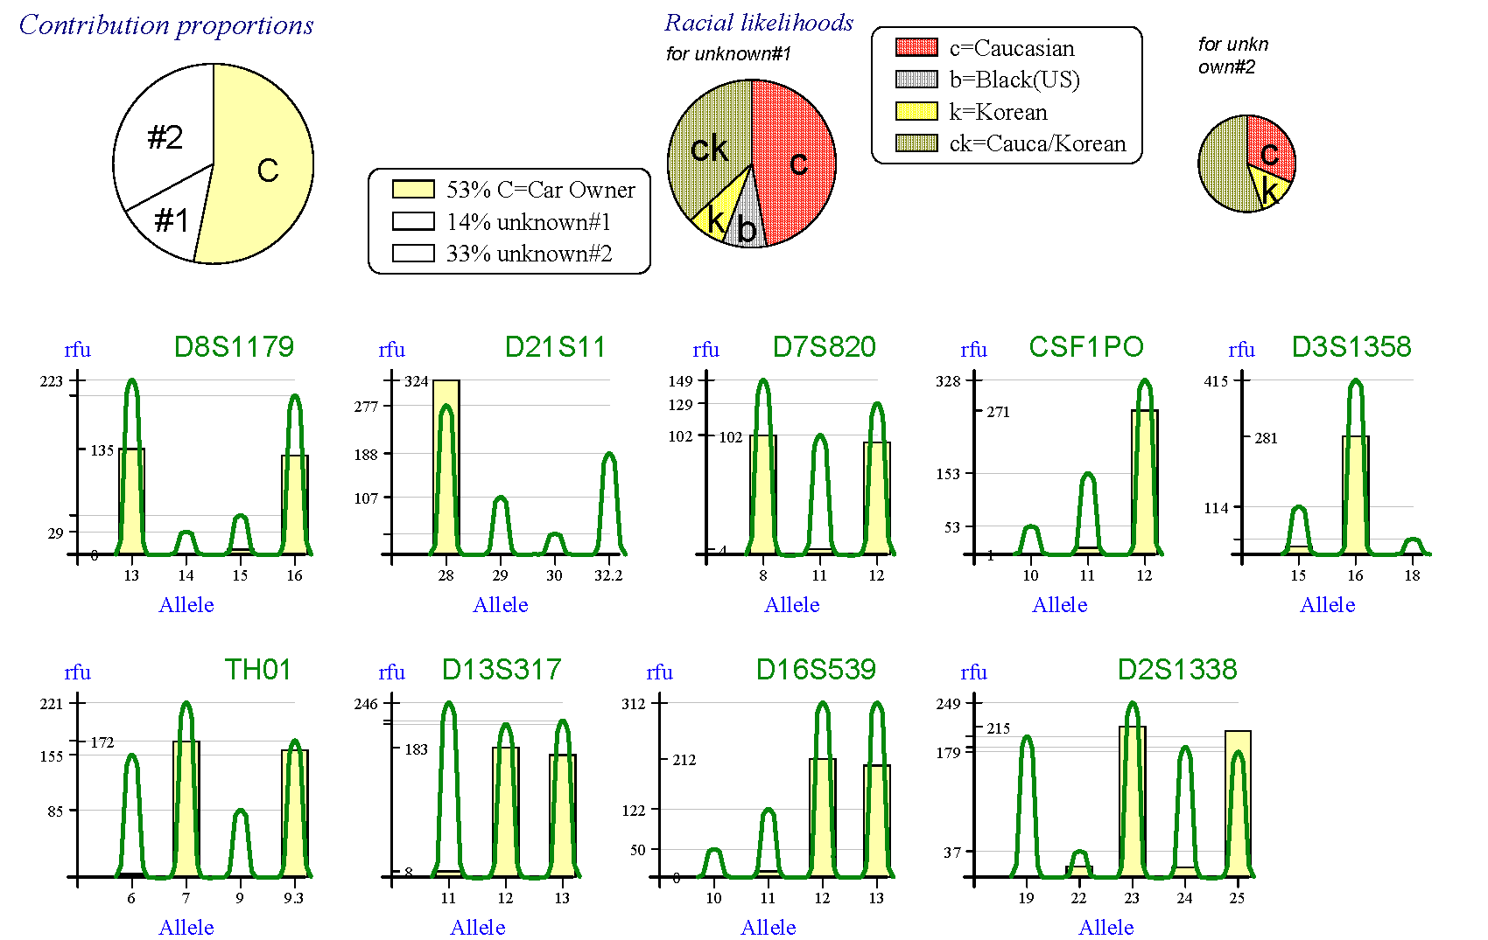
Visual aids
Car owner & 2 unknowns

Slide 15
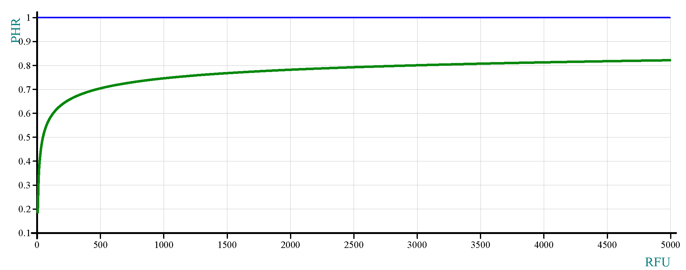
Visual aids
Stochastic variation model
One σ of peak height ratio

Slide 16
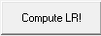
Input & output
Import mixture & reference profiles
    Allele calls, peak heights, etc
      Osiris or GeneMapper
    Threshold: minimal (30rfu?)
Choose
    Mixture
    Hypotheses (any #)
    Range of #s of unknowns
    Race(s) of interest
Advanced (parameters)
    Stochastic model
    Time budget
Output
  Likelihood ratios
    LR < 1/Pr(suspect profile), but maybe almost
  Visual Aids

Slide 17
ISHI 2014 workshop example first look
Given
  Mixture (no stutter filtering)
    U=mixture @ 35 rfu cutoff, or
    W=mixture @ 20 rfu cutoff
  References
    C=Car owner
    S=suspect #1
    T=suspect #2
Preliminary observations
  C: looks like major contributor
  S: clearly included
  T: some alleles missing; explains some others
Hypotheses to consider
  CST & 0-4 unknowns
  CS, CT, or ST & 0-4 unknowns
  C, S, or T & 0-4 unknowns
  0-4 unknowns

Slide 18
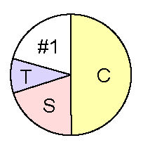
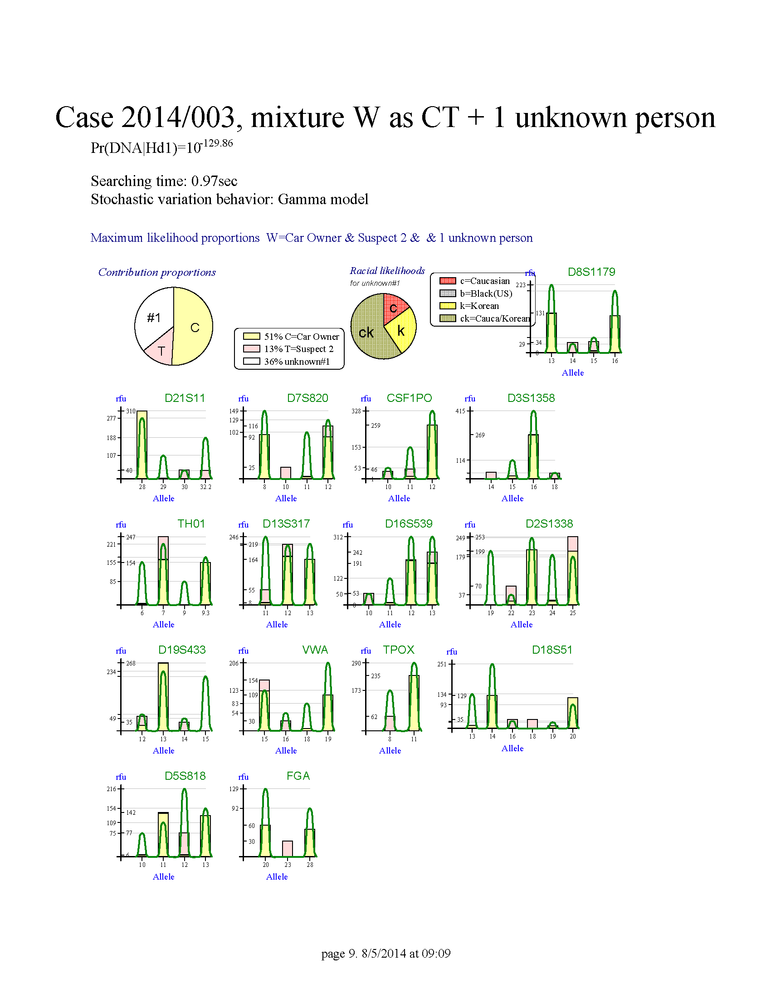
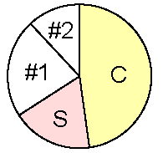
workshop example
Mixture Solution results & mystery
Hp (best explanation for mixture) = CST+1unk
  (Car owner + both suspects + 1 unknown)
  optimum proportions C:S:T:unk
Hd for S (Suspect 1), is CT+1unk (i.e. best explanation without S)
  S alleles plainly all seen in mixture.
  Yet LR_{S}(Hp vs Hd-S)= 130 – not impressive!
Hd for T (Suspect 2), is CS+2unk. (Why 2 unk?)
  T alleles NOT all seen in mixture.
  Yet LR_{T}(Hp vs Hd-T)= 2000 – strong inclusion!
Note 4 contributors vs 3

Slide 19
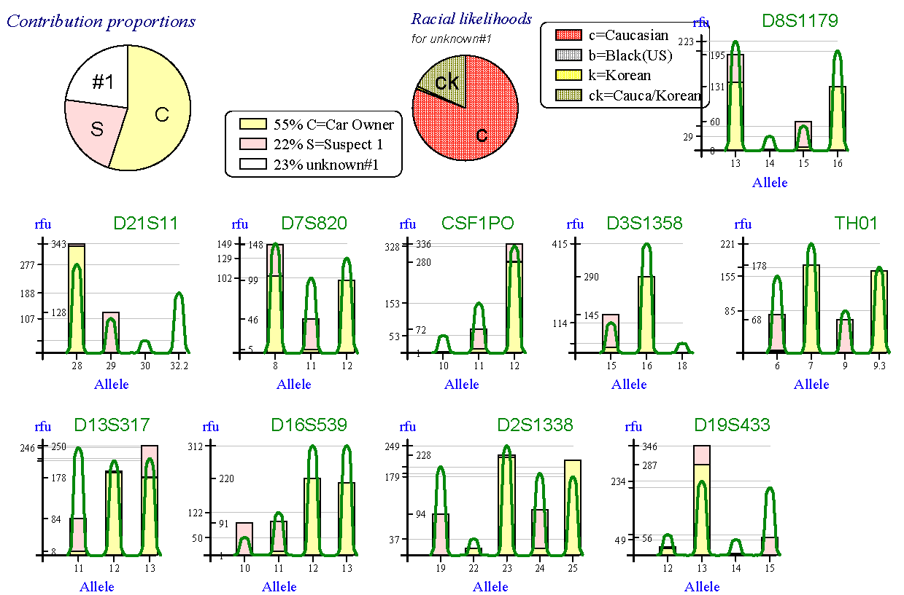
workshop example why Suspect 1 maybe didn’t contribute
Car owner + Suspect 1 + 1 unknown is a poor explanation for the mixture, according to Mixture Solution.
Why? Loci D21 & D19
hard to explain!
hard to explain!

Slide 20
workshop example
What if Suspect 1 didn’t contribute?
Look at C+T+1 unk & see who/what did
“Mock mechanic”=
  D8(13,16) D21(29,32.2) … FGA(20,28)
  (=real mechanic except FGA)
M & S are brothers!
  LR=2 million
  Typically Korean alleles (per DNA·VIEW’s Racial estimate)
Aha. Related!

Slide 21
workshop example
Aha
Mixture Solution (currently) unaware of relatedness
  “confused” by brothers, proposed 4-person
    explanation including S
(For fun) compare Hp=CTM vs Hd=CM+unknown
  LR=1 trillion that T is in the mixture
  That’s reassuring even though inventing an M is dodgy.
  (“Korean” included in the race list or LR even higher)
Ideal Hp: mixture=C+T+unknown brother of S
Hd(T): mixture=C+brother of S+brother of T ?
(expect next year)

Slide 22
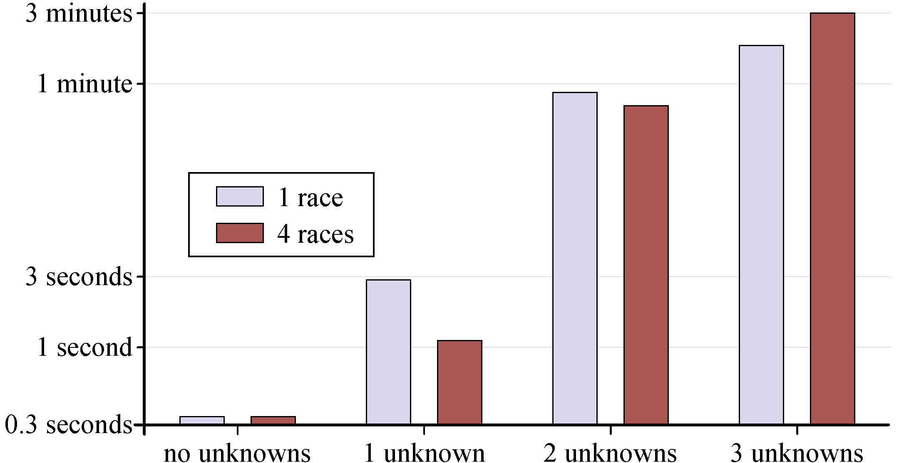
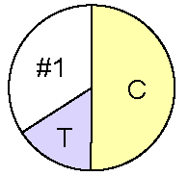
workshop example
Timing etc
Phase I: LR at most likely mixture proportions
4 minutes total for 3 hypotheses: Hp, Hd(S), Hd(T) – i.e. preliminary calculations for both suspects.
Phase II – LR averaging over mixture proportions (more logical result)
Example elapsed times for both I & II:
1) 10 minutes (for Hp and best two Hd as above).
1 hour to explore & compare all pairs Hp(T) and Hd(T) of hypotheses
  (eg CST+black+white unknowns vs C+white & 2 Korean unknowns)

Slide 23
Validation & Verification
Validation
  Plan: test all Boston U examples
  Excellent NIST 2013 & ISHI test results
  Robust: not sensitive to parameter variation
  Visual aids help greatly
  Parallel development & cross-testing of 2 versions
  Test against special cases
Calibration
  should use comparable validation samples

Slide 24
Support & miscellaneous
1-time license fee (1 or more “seats”)
  25 year history of DNA·VIEW support
  1st year of support & upgrades included
PC Windows program
  Mac? Virtual box. Unix? Ask.

Slide 25
Model attributes
Biochemical model
  As complicated as necessary
  As simple as possible
    Testing, speed, flexibility, reliability
Casework model
  Many suspects and/or possible hypotheses
  Automatic evaluation decides among hypotheses
  Simple yet conservative?
    Defense-friendly stochastic model
Notes:
Defense friendly stochastic model: 1) Adjust stochastic parameters. 2) ?

Slide 26
Summary of features
Visual aids
Automatic evaluation of all combinations
  References, unknowns, races, proportions
Numbers of contributors
  Prosecution & defense may differ
  Optimum # determined automatically
Calculation, not simulation
  All genotype combinations for unknowns
Fast, very

Slide 27
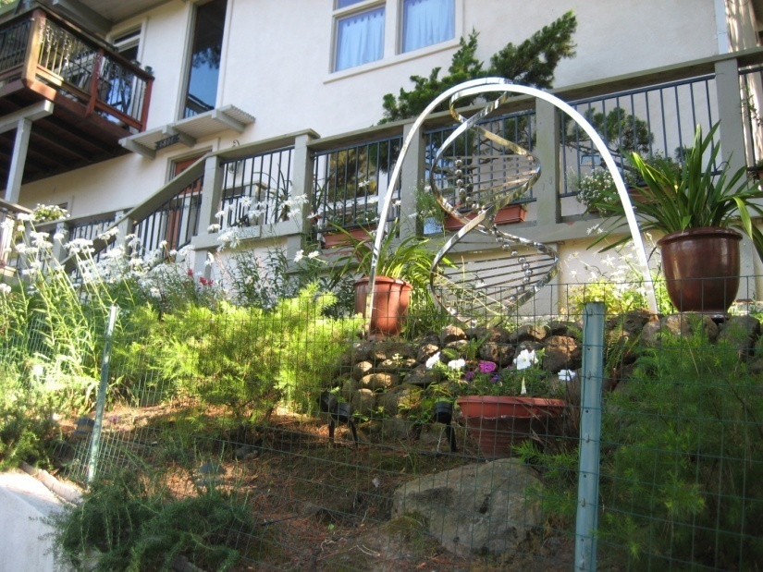
Where does it stand?
Current state
  Works extremely well already
    Program explores alternatives, decides
  Some labs experimenting with it.
  fast, & easy to use
Plans
  kinship mixture hypotheses!
    “mixture is A & 2 unknown brothers”
  Y, Amelo, non-STR (easy)
  even faster
  automatic evaluation of calibration data
  Windows release this year.
    Later add remaining DNA·VIEW modules (Kinship, Paternity, MVI, etc.)
DNA garden
Charles Brenner, PhD
c@dna-view.com
http://dna-view.com

